Slide 1

Youth Mental Health First Aid (YMHFA) Training
PRESENTED BY
NATIONAL CHILDREN AND YOUTH SERVICES
July 31, 2026

Slide 2
Youth Mental Health First Aid (YMHFA) Training
Welcome to the Youth Mental Health First Aid training, designed to equip adults working with youth to recognize, respond, and support young people facing mental health challenges. This 4-hour session (expandable to 8 hours) covers essential skills like early warning signs, trauma-informed approaches, and crisis response. Participants will learn practical tools to foster resilience, reduce stigma, and ensure youth safety, ultimately promoting healthier communities and better long-term outcomes for young people.
Made with SlideMaker.app

Slide 3

Understanding Youth Mental Health
Prevalence of Disorders
Importance of Early Intervention
Nearly 1 in 5 children experience a mental health disorder each year, yet many remain undiagnosed or untreated, highlighting the need for awareness and early support.
Timely response to warning signs can greatly improve long-term outcomes, reducing the severity of mental health issues and preventing crises among youth.
Recognizing Warning Signs
Signs such as withdrawal, mood swings, or changes in behavior may appear months before a crisis, emphasizing the importance of vigilance and proactive support.
Made with SlideMaker.app

Slide 4

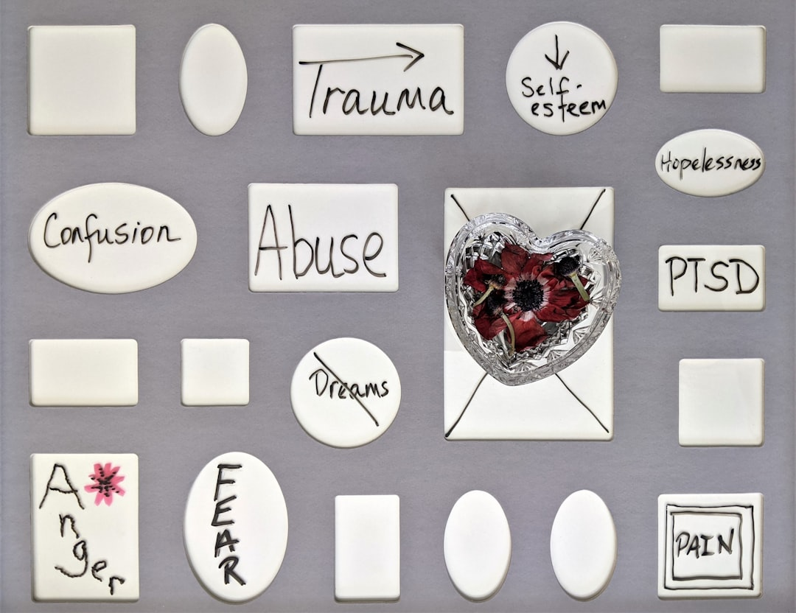
Common Mental Health Disorders in Youth
Anxiety Disorders
Depression
Trauma and PTSD
Signs include constant worry, panic attacks, sleep disturbances, physical complaints, school avoidance, and difficulty concentrating, affecting 7% of youth annually.
Persistent sadness, irritability, withdrawal, fatigue, appetite changes, hopelessness, and loss of interest are common, impacting approximately 3.2 million adolescents each year.
Youth exposed to abuse, neglect, or violence may show hypervigilance, flashbacks, aggression, emotional numbness, and trust issues, especially in foster care settings.
Made with SlideMaker.app

Slide 5

Recognizing Warning Signs of Crisis
Immediate Danger Indicators
Behavioral Warning Signs
Watch for talking about death, giving away possessions, self-harm, extreme mood swings, social withdrawal, hopelessness, and panic attacks to identify urgent mental health crises early.
Sudden behavior changes, aggressive actions, or withdrawal from activities may signal distress, requiring prompt attention to prevent escalation into a crisis.
Importance of Early Identification
Recognizing these signs allows timely intervention, reducing risks of self-harm, suicide, or severe emotional breakdowns, especially in vulnerable youth populations.
Made with SlideMaker.app

Slide 6


Trauma-Informed Care Principles
Safety
Trust
Choice & Collaboration
Create a physically and emotionally secure environment for youth, ensuring they feel protected and supported, which is essential for healing and building trust.
Be honest, keep promises, and build reliable relationships to foster safety and encourage youth to share their experiences without fear of judgment.
Empower youth by offering options whenever possible, working together, and focusing on their strengths to promote resilience and active participation.
Made with SlideMaker.app

Slide 7

Active Listening & Communication Skills
Use Open-Ended Questions
Maintain Calm & Eye Contact
Encourage youth to express feelings by asking questions that require more than yes/no answers, fostering trust and understanding during support conversations.
Use a calm voice and steady eye contact to create a safe environment, helping youth feel heard and validated, which promotes openness and emotional safety.
Reflective Listening & Empathy
Mirror youth's words and show genuine empathy to validate their feelings, strengthening trust and encouraging honest communication in crisis situations.
Made with SlideMaker.app

Slide 8


The ALGEE Action Plan
Assess for Risks
Listen Without Judgment
Give Reassurance
Evaluate youth for suicide risk, self-harm, or immediate danger, ensuring safety and determining if urgent professional intervention is needed.
Allow youth to express feelings freely, validate their emotions, and create a safe space using open-ended questions and empathetic responses.
Offer hope and normalize help-seeking, avoiding dismissive language like 'just get over it,' to foster trust and reduce feelings of isolation.
Made with SlideMaker.app

Slide 9

Responding to Panic Attacks & Self-Harm
Remain Calm and Reassure
Use Grounding Techniques
Stay calm, encourage slow breathing, and remain nearby to provide reassurance, helping youth feel safe and supported during acute distress.
Guide youth to identify five things they see, four they feel, three they hear, two they smell, and one they taste to reduce anxiety and regain control.
Address Self-Harm Directly
Ask openly about self-harm behaviors, assess immediate safety, and connect youth to professional care without shame or secrecy, prioritizing their safety.
Made with SlideMaker.app

Slide 10
Trauma-Informed Care vs Traditional Support Approaches
Trauma-Informed Care
Traditional Support Approaches
• Prioritizes safety, trust, and empowerment to reduce re-traumatization
• May emphasize discipline and behavior management without addressing underlying trauma
• Focuses on understanding the impact of trauma on youth behavior and emotions
• Often relies on standard protocols that do not consider cultural or individual trauma histories
• Uses collaborative and strength-based strategies to support healing
• Can inadvertently overlook emotional safety, leading to re-traumatization or mistrust
Made with SlideMaker.app

Slide 11
Impact of Youth Mental Health First Aid
1 in 5
80%
False
Children Affected Annually
Early Warning Signs
Asking About Suicide
Nearly 20% of youth experience a mental health disorder each year, yet many go untreated
Youth often show signs months before a crisis occurs, highlighting the importance of early intervention
Research shows that directly asking does NOT increase risk and can save lives
Made with SlideMaker.app

Slide 12
Frequently Asked Questions
Q: Does asking a youth about suicide increase their risk?
A: No, asking directly can save lives by opening a crucial conversation and does not increase the risk.
Q: Can I diagnose mental health conditions during Youth Mental Health First Aid?
A: No, but you can recognize warning signs and refer the youth to professionals for proper assessment.
Q: How should I approach cultural differences when supporting youth?
A: Respect their beliefs, use interpreters if needed, and focus on their cultural strengths to build trust.
Q: What if I feel overwhelmed or unsure about handling a situation?
A: Practice self-care, seek supervision, and connect with peer support to maintain your well-being.
Made with SlideMaker.app

Slide 13
Key Takeaways
Effective youth mental health first aid involves early recognition, trauma-informed approaches, and supportive responses. By understanding warning signs and promoting resilience, adults can significantly impact youth well-being. Ongoing education and compassionate engagement are essential to reduce stigma and foster safe environments. Every supportive adult plays a vital role in guiding youth toward recovery and healthy development. Committing to continuous learning and applying trauma-informed principles ensures we create a community where young people feel safe, valued, and empowered to seek help when needed.
Made with SlideMaker.app

